Slide 1

Home Credit Default Risk: Can you predict how capable each applicant is of repaying a loan?
Present by: Jasmine Zeng

Slide 2

Background & Business Need
Home Credit Group wants to enhance reviewing process to efficiently capture suspicious loan applicant who has high probability of default.
They want a classification model which could predict the default probability of a given client that could help their reviewing process.
Goal: to devise classification model and campaign with better target reviewing process in loan application.

Slide 3

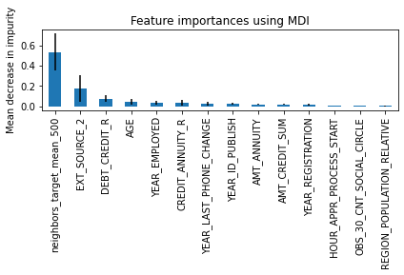
Loan Applicants Data
Some important features
A feature engineered using KNN
Credit score
Debt/Credit rate
Age
Professional Experience
Credit/Annuity rate

Slide 4
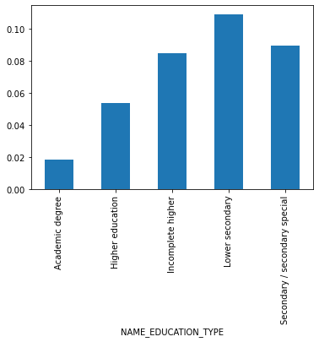
Feature Engineering
500 neighborhood feature engineering:
calculate the average default rate of 500 nearest points based on distance calculated from credit score and annuity rate.
Credit Annuity Rate:
credit amount/annuity amount
Educational Level:
Change from categorical feature to ordinal feature
Region population relative level

Slide 5
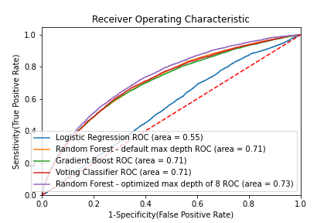
Candidate model Cross Validation Result – Scoring Metrics ROC AUC
Candidate Models CV score:
Logistic Regression: 0.573
Random Forest (Selected): 0.705
Gradient Boost: 0.696
Optimize max_depth by CV:
Best max_depth is 8
ROC AUC improves for 0.704 to 0.730
Final score on test dataset: 0.730

Slide 6

What is our solution?
Solution path:
Tech: Use Classification model to forecast a given client’s default rate
Non-Tech: Review the 5 most important features of each applicant and be cautious with clients who have any flags in those features
Criteria for Success:
Tech: Accurate model (ROC-AUC score)
Non-Tech: A decrease in overall default rate of all approved applicants

Slide 7

Risk and Assumptions
Assumption:
New applicants’ behavior are similar to old clients.
Risk:
May present discrimination to certain age and sex group people - Morality Risk

Slide 8

Thank you!

